Slide 1
Lending Club Data Analysis

Slide 2
Problem
Credit decisioning process at many financial institutions relies almost entirely on FICO scores
Can we look at alternative data points in order to identify good credits?

Slide 3
Data Acquisition
Lending Club has a wealth of data available on their website
All their lending data since 2007, when the company started, is available on their website

Slide 4
Data Clean-Up
The data set consists of several hundred thousand loans with 145 features a piece
After going through the dictionary, there are many features that aren’t relevant (membership ID) or highly correlated (funded amount and funded amount invested)
Narrowed the data down to 15 categories for analysis
Sorted the data into Fully Paid or Charged Off categories
Removed any incomes over $10m and filled nulls with means

Slide 5
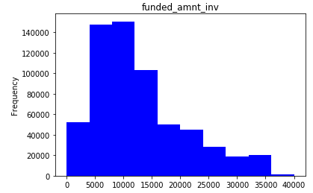
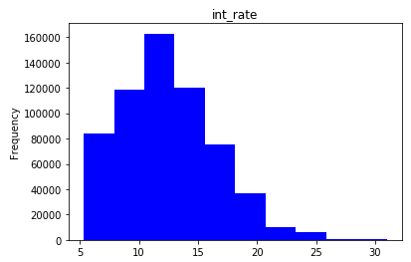
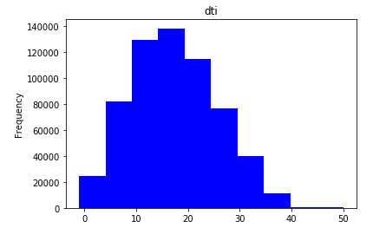
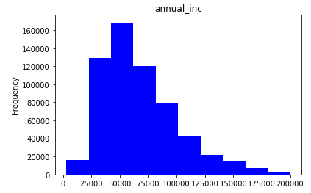
Exploratory Analysis

Slide 6
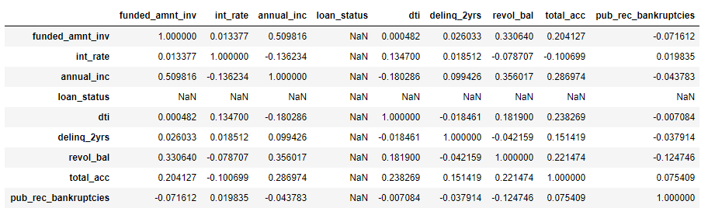
Exploratory Analysis

Slide 7
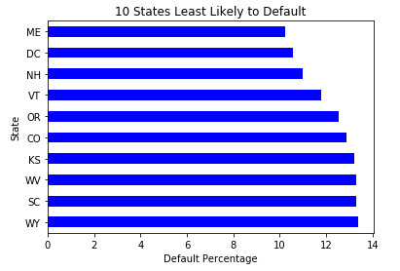
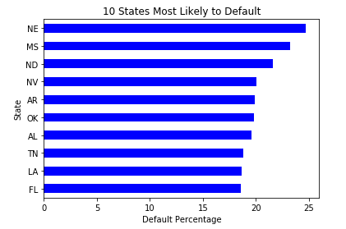
Default Percentage By State

Slide 8
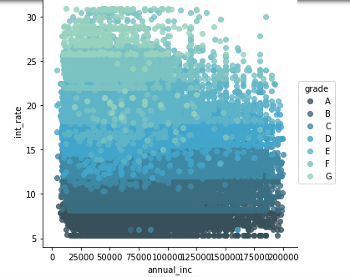
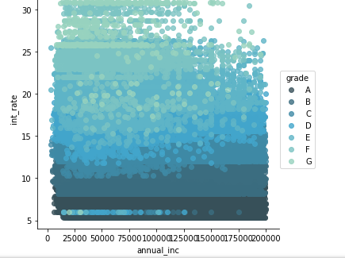
Charged Off (L) and Fully Paid (R)

Slide 9
Issues with the Data
Default rate of 17% made it difficult to see the impact of my models
When I filtered for the high yield segment of interest rates over 25% this number shot up to 41% default rate, which became the baseline

Slide 10
Models

Slide 11
Feature Importance
Total credit allocated to them was the most important
Interest rate, loan amount and annual income were also important
Surprisingly unimportant were previous delinquencies and previous bankruptcies

Slide 12
Further Analysis
New set of Lending Club data coming out soon, test on that
Deeper dig into predictions on bad loans
More systematic approach to feature selection
Blended models
Greater hyperparameter optimization

